Slide 1
CPS 516: Data-intensive Computing Systems
Instructor: Shivnath Babu
TA: Zilong (Eric) Tan

Slide 2
The World of Big Data
eBay had 6.5 PB of user data + 50 TB/day in 2009
From http://www.umiacs.umd.edu/~jimmylin/

Slide 3
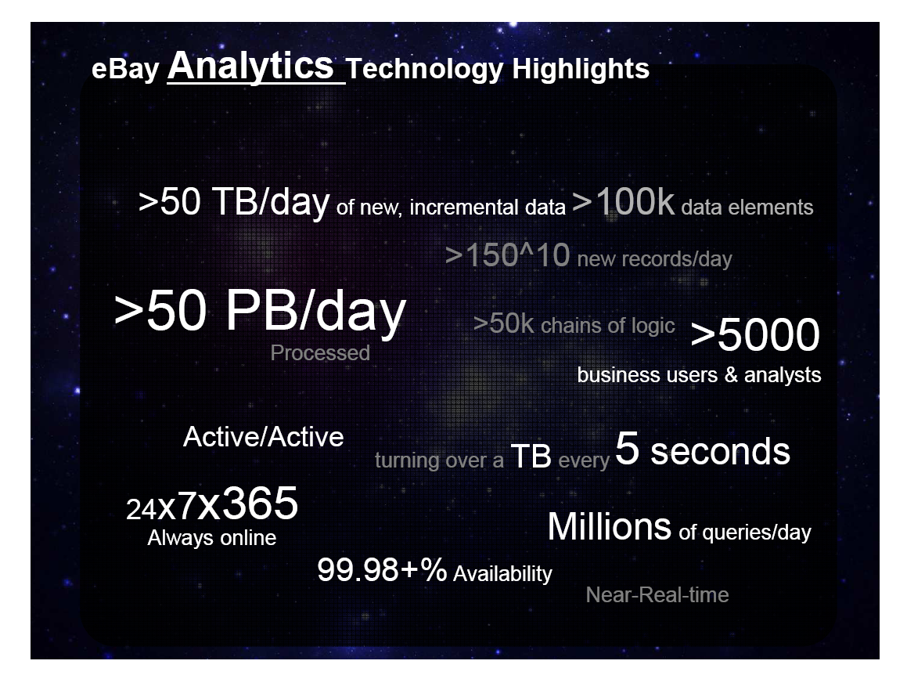
From: http://www.cs.duke.edu/smdb10/

Slide 4
The World of Big Data
eBay had 6.5 PB of user data + 50 TB/day in 2009
How much do they have now?
See http://en.wikipedia.org/wiki/Big_data
Also see: http://wikibon.org/blog/big-data-statistics/
From http://www.umiacs.umd.edu/~jimmylin/

Slide 5
Fox Audience Network
Greenplum parallel DB
42 Sun X4500s (“Thumper”) each with:
48 500GB drives
16GB RAM
2 dual-core Opterons
Big and growing
200 TB data (mirrored)
Fact table of 1.5 trillion rows
Growing 5TB per day
4-7 Billion rows per day
Also extensive use of R and Hadoop
Yahoo! runs a 4000 node Hadoop cluster (probably the largest). Overall, there are 38,000 nodes running Hadoop at Yahoo!
From: http://db.cs.berkeley.edu/jmh/
As reported by FAN, Feb, 2009

Slide 6
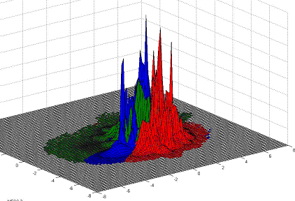
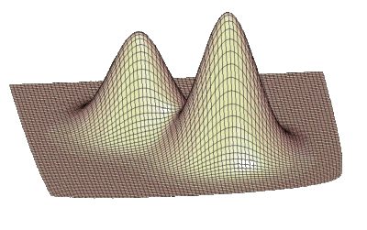
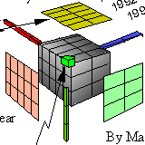


How many female WWF fans under the age of 30 visited the Toyota community over the last 4 days and saw a Class A ad?
How are these people similar to those that visited Nissan?
Open-ended question about statistical densities (distributions)
From: http://db.cs.berkeley.edu/jmh/

Slide 7
“No One Size Fits All” Philosophy
Non-relational
Relational
Analytic
Hadoop
Mapr
Hadapt
Teradata Aster
RainStor
EMC Greenplum
SAP Sybase IQ
IBM Netezza
Dryad
MapReduce Online
HP Vertica
Infobright
Calpont
MapReduce
Brisk
GridGrain
Platfora
Spark
Shark
Dremel
Impala
Operational
In-memory
Druid
SAP HANA
NoSQL
Oracle
IBM DB2
SQL Server
DataStax Enterprise
Neo4J
PostgreSQL
MySQL
LevelDB
Hypertable
HBase
DEX
OrientDB
-as-a-Service
Sap Sybase
ASE
Cassandra
Amazon RDS
Google Cloud SQL
SQL Azure
ClearDB
FathomDB
Database.com
Riak
Big tables
Graph
AppEngine
Datastore
NuvolaBase
EnterpriseDB
Redis
SimpleDB
DynamoDB
-as-a-Service
NewSQL
New databases
SQLFire
VoltDB
Voldemort
MongoHQ
Cloudant
-as-a-Service
MemSQL
Drizzle
NuoDB
CouchBase
MongoDB
StormDB
Key value
Document
RavenDB
Xeround
GenieDB
Clustrix
SchoonerSQL
Storage engines
Clustering/sharding
ScaleArc
Solr
HyperDex
Tokutek
ScaleDB
ScaleBase
Continuent
Lucene
Xapian
Lotus Notes
MySQL Cluster
Search
Sphinx
ElasticSearch
Streaming
Esper
Gigascope
STREAM
DejaVu
MarkLogic
InterSystems
Storm
Borealis
Oracle CEP
DataCell
SQLStream
Versant
Starcounter
Muppet
S4
StreamBase
Truviso
Progress
An extension of the figure given in http://blogs.the451group.com/information_management/2012/11/02/updated-database-landscape-graphic

Slide 8
What we will cover in class
Scalable data processing
Parallel query plans and operators
Systems based on MapReduce
Scalable key-value stores
Processing rapid, high-speed data streams
Principles of query processing
Indexes
Query execution plans and operators
Query optimization
Data storage
Databases Vs. Filesystems (Google/Hadoop Distributed FileSystem)
Data layouts (row-stores, column-stores, partitioning, compression)
Concurrency control and fault tolerance/recovery
Consistency models for data (ACID, BASE, Serializability)
Write-ahead logging

Slide 9
Course Logistics
Web pages: Course home page will be at Duke, and everything else will be on github
Grading:
Three exams: 10 (Feb) + 15 (March) + 25 (April) = 50%
Project: 10 (Jan 21) + 10 (Feb 1 – Feb 21) + 10 (Feb 22 – March 10) + 20 (March 11 – April 15) = 50%
Books:
No one single book
Hadoop: The Definitive Guide, by Tom White
Database Systems: The Complete Book, by H. Garcia-Molina, J. D. Ullman, and J. Widom

Slide 10
Project Part 0: Due in 2 Weeks
For every single system listed in the “Data Platforms Map”, give as a list of succinct points:
Strengths (with numbered references)
Weaknesses (with numbered references)
References (can be articles, blog posts, research papers, white papers, your own assessment, …)
Your own thoughts only. Don’t plagiarize. List every source of help. We will enforce honor code strictly.
Submit on github (md format) into repository given by Zilong
Outcomes: (a) Score out of 10; (b) Project leader selection.

Slide 11
Project Parts 1, 2, 3
Shivnath/Zilong will work with project leaders to assign one system per project. Will also try to have one mentor per project
Each student will join one project. Project starts Feb 1
Part 1: Feb 1 – Feb 21
Install system
Develop an application workload to exercise the system
Run workload and give demo and report
Part 2: Feb 22 – March 15
Identify system logs/metrics and other data that will help you understand deeply how the system is running the workload
Collect and send the data to a Kafka/MySQL/ElasticSearch routing and storage system set up by Shivnath/Zilong. Give demo and report
Part 3: March 16 to April 15
Analyze and visualize the data to bring out some nontrivial aspects of the system related to what we learn in class. Give demo and report

Slide 12
Primer on DBMS and SQL

Slide 13
Data Management
Query
Query
Query
User/Application
Data
DataBase Management System (DBMS)

Slide 14
Example: At a Company
Query 1: Is there an employee named “Nemo”?
Query 2: What is “Nemo’s” salary?
Query 3: How many departments are there in the company?
Query 4: What is the name of “Nemo’s” department?
Query 5: How many employees are there in the
“Accounts” department?
Employee
Department
ID | Name | DeptID | Salary | …
10 | Nemo | 12 | 120K | …
20 | Dory | 156 | 79K | …
40 | Gill | 89 | 76K | …
52 | Ray | 34 | 85K | …
… | … | … | … | …
ID | Name | …
12 | IT | …
34 | Accounts | …
89 | HR | …
156 | Marketing | …
… | … | …

Slide 15
DataBase Management System (DBMS)
High-level
Query Q
Answer
Translates Q into
best execution plan
for current conditions,
runs plan
DBMS
Data

Slide 16
Example: Store that Sells Cars
Owners of
Honda Accords
who are <=
23 years old
Make | Model | OwnerID | ID | Name | Age
Honda | Accord | 12 | 12 | Nemo | 22
Honda | Accord | 156 | 156 | Dory | 21
Join (Cars.OwnerID = Owners.ID)
Filter (Make = Honda and
Model = Accord)
Filter (Age <= 23)
Cars
Owners
Make | Model | OwnerID
Honda | Accord | 12
Toyota | Camry | 34
Mini | Cooper | 89
Honda | Accord | 156
… | … | …
ID | Name | Age
12 | Nemo | 22
34 | Ray | 42
89 | Gill | 36
156 | Dory | 21
… | … | …

Slide 17
DataBase Management System (DBMS)
High-level
Query Q
Answer
Translates Q into
best execution plan
for current conditions,
runs plan
DBMS
Keeps data safe and correct despite failures,
concurrent updates, online processing, etc.
Data

